Slide 1
Blind Deblurring Using Internal Patch Recurrence
GROUP 3:
Yifeng Huang, Zijian Qiao
Yunzhe Cao, Shangru Huang

Slide 2
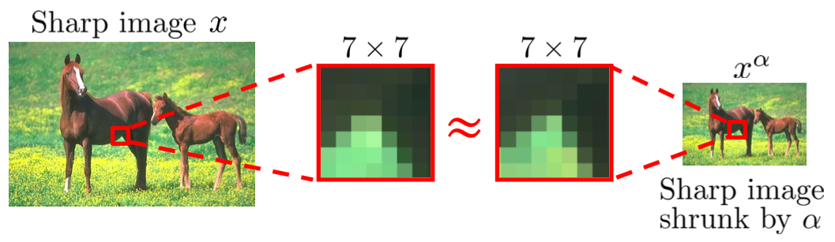
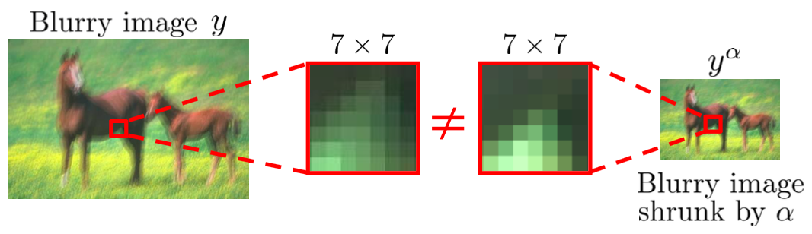
Internal Patch Recurrence
Patch recurrence across scales in a sharp image
In a blurry image, cross-scale patch recurrence deminishes

Slide 3
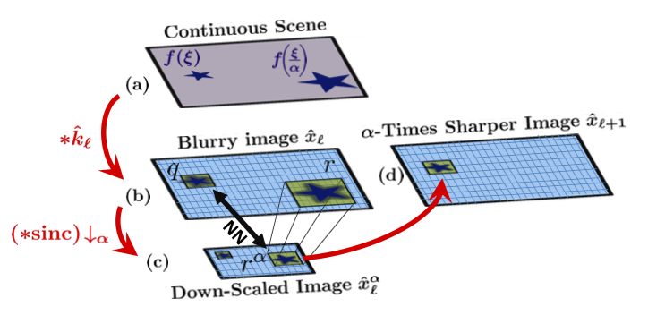
T. Michaeli and M. Irani
Step 1: Down scale Find nearest neighbor (NNs)

Slide 4


T. Michaeli and M. Irani
Step 2: Deblurring Using Internal Patch Recurrence
Step 3: Kernel Update

Slide 5

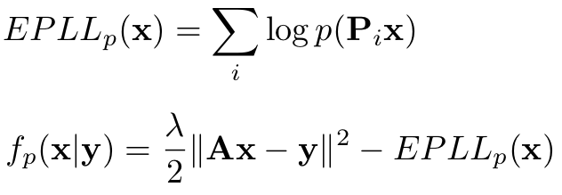
D. Zoran and Y. Weiss
Learn Prior
Restore image by maximizing Expected Patch Log Likelihood (EPLL)

Slide 6
epll的比较

Slide 7
Auto Crop

Slide 8
motion跑几张图

